Slide 1
Interrupts for SW3 & SW4

Slide 2
What is an interrupt
Pauses execution of current function (typically main)
Transfers control to another function (interrupt handler)
SysTick_Handler, EINT3_IRQHandler, EINT0_IRQHandler
After (short) processing in interrupt handler, control is returned to the previous function
Eg. when OLED display is updating sensor readings, pressing SW3 will immediately pause OLED updating, display ‘3’ on 7-seg display, toggle RGB LEDs and resume OLED updating. The momentary pause of OLED updating is hardly noticeable

Slide 3
Why use interrupts?
Program will be more responsive
Faster than using while(1) for event detection
User input is processed instantly
Eg. without interrupts, it may take multiple presses of a pushbutton before the input is recognised

Slide 4
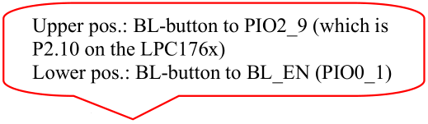
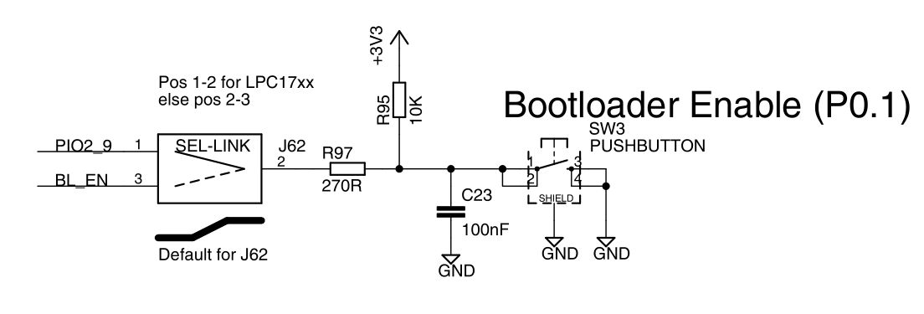
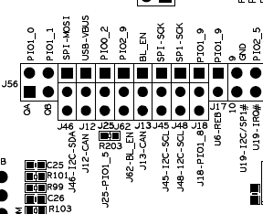
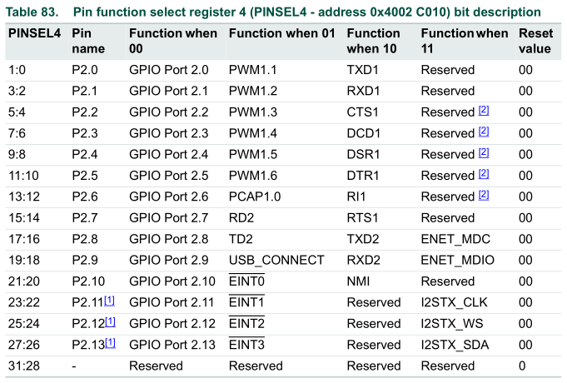
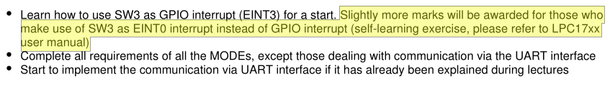
SW3 schematic and jumper
P2.10
P0.4
SW3
Use J62 jumper to select for SW3: PIO2_9 (P2.10) or BL_EN (P0.4)
We choose PIO2_9 (P2.10) (for EINT0) to get more marks 😛

Slide 5
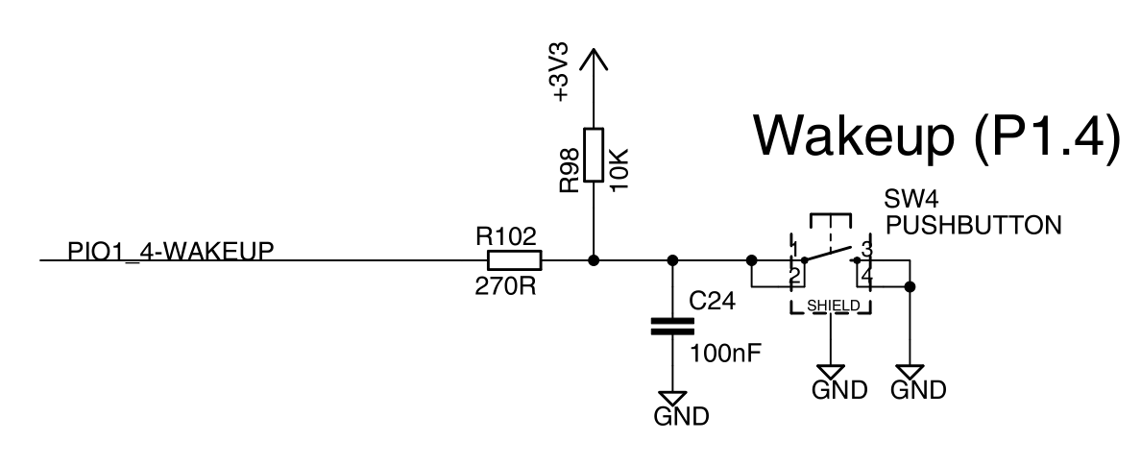
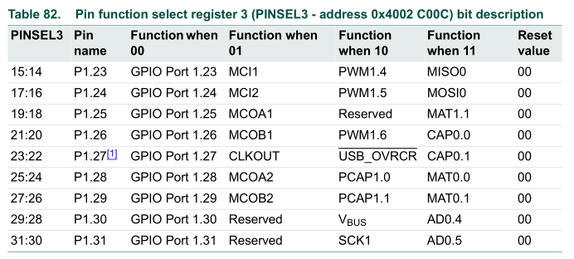
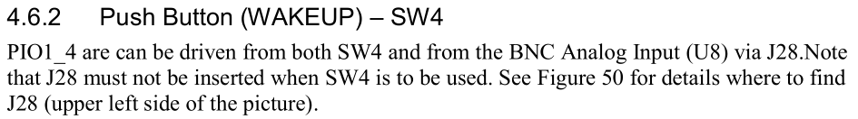
SW4 schematic and jumper
P1.31
SW4
Unlike SW3, which can be read using EINT0/EINT3 (GPIO Interrupt), SW4 is on port 1, which doesn’t have any interrupts
So we remove J28 and we have an unused jumper. What if we can use this spare jumper to short PIO1_4 to an adjacent pin that is connected to LPC P0/P2? 😏
If we do that, we can have a GPIO interrupt (EINT3) on the adjacent pin
Which also means that SW4 now can have an interrupt!!!

Slide 6
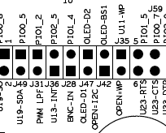
Jumper schematic
P2.5
P1.31
PIO2_5 is unused (so far) and unlikely to be used in future so we short PIO1_4 to PIO2_5 and enable GPIO interrupt (EINT3) on P2.5. So SW4 now has an interrupt. #hacked 😜

Slide 7
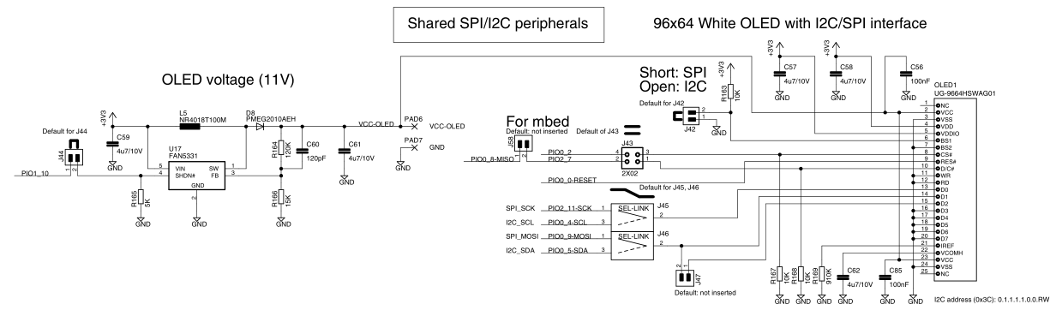
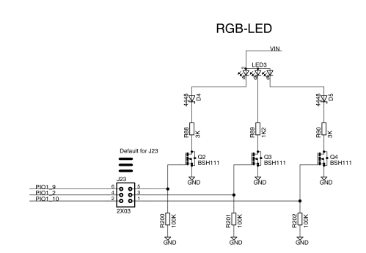

Assignment requires only red and blue LEDs to be blinked; better to off green LED. But PIO1_10 (P1.10) is controlling both green LED and OLED display

Slide 8
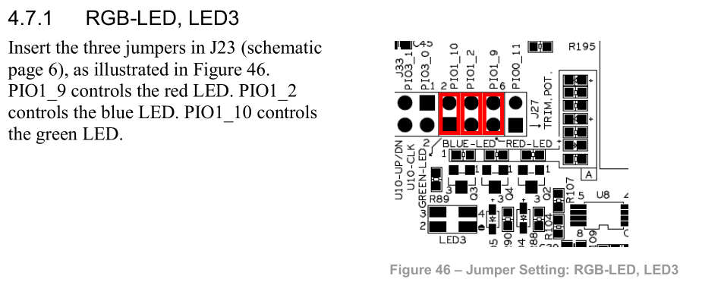
So we remove the jumper for PIO1_10 so that green LED always remains off.

